Slide 1
Webinar on Refocus, Retool, Reset, Supporting Young Entrepreneurs Post-pandemic
Online webinar, 10 March 2022 15:00-16:00 CET

Slide 2
Webinar on Refocus, Retool, Reset, Supporting Young Entrepreneurs Post-pandemic
Opening by Sukti Dasgupta, Chief, Employment, Labour Markets and Youth Branch (EMPLAB), International Labour Organization

Slide 3
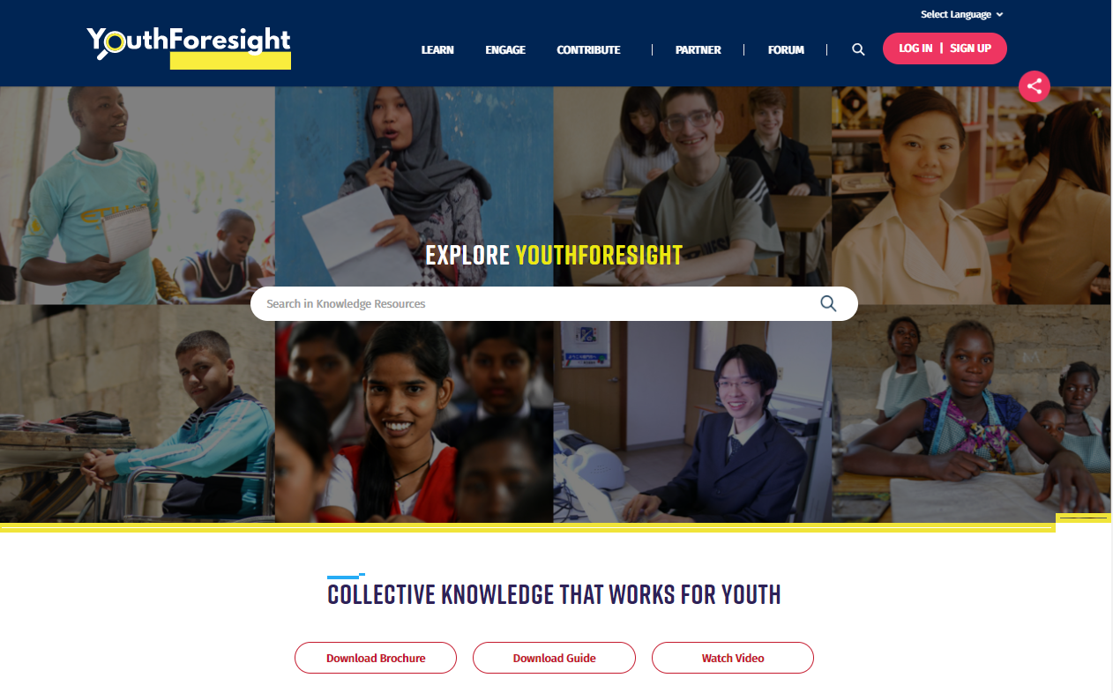
YouthForesight - A Joint Knowledge Facility - youthforesight.org/
A one-stop shop with knowledge resources for evidence-based action on education and skilling, employment, entrepreneurship, and engagement for youth, built on the existing Decent Jobs for Youth knowledge facility.
YouthForesight includes more than 1000 knowledge resources so far from over 70 knowledge partners. The YouthForesight Community Forum provides a space for stakeholders to connect, share and collaborate.
Sign up to receive updates!

Slide 4
Speakers
Rowan Barnett, Head of Google.org, Europe, Middle East & Africa
Anita Tiessen, CEO, Youth Business International (YBI)
Veronica Colondam, CEO and Founder YCAB, YBI Member in Indonesia
Theodore Klouvas, Department of Social Development, TVET & Higher Education, Ministry of Foreign Affairs, The Netherlands
Joshua van den Hurk, Founder, Bamboovement
Agenda
Welcome and introduction
Presentation of report by Youth Business International
Discussion between panellists from YBI member, Google.org, young entrepreneur and policy maker
Q & A with the audience

Slide 5
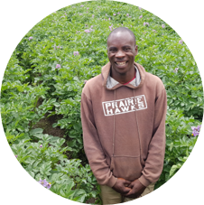
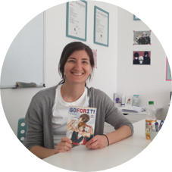
Who is Youth Business International?
YBI supports young people (18-35) around the world to start, grow and sustain businesses.
Together with our members, we equip disadvantaged young people to build the skills, confidence and connections they need to beat the odds and become successful business owners.
We design programmes and resources specifically for delivery to young people, recognizing the difference this makes to the sustainability and growth of youth-led businesses.

Slide 6
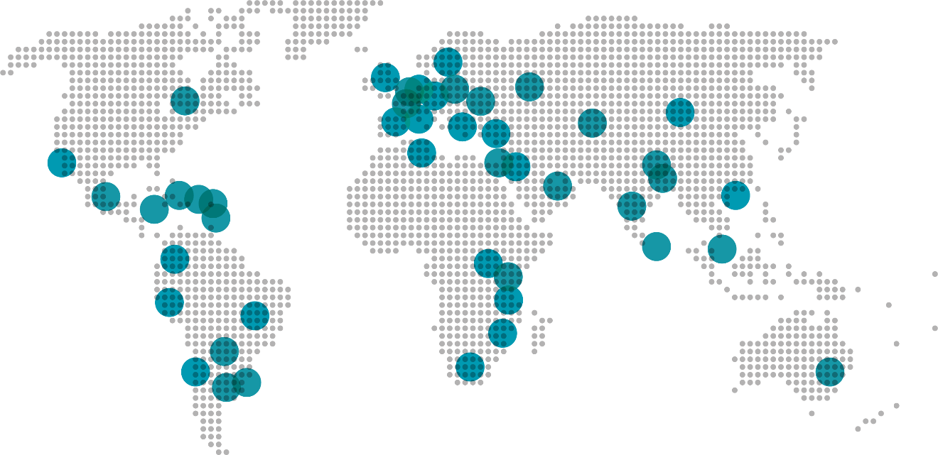
A global network
We sit at the centre of a global network of entrepreneurship support organisations, themselves innovative local engines of youth entrepreneurship. We are a platform for our members to exchange ideas, knowledge and insights, and to collaborate in a way that catalyses entrepreneurs’ success and multiplies impact.

Slide 7
Refocus, Retool, Reset:
COVID-19 Rapid Response & Recovery Programme with Google.org
With the support from Google.org and of Google employees, Youth Business International used its 20 years of experience providing integrated support for youth entrepreneurship and its global network of expert members to deliver programmes in 32 countries globally to help entrepreneurs.

Slide 8
Summary of results

Slide 9
For long-term recovery young entrepreneurs need:

Slide 10
For long-term recovery young entrepreneurs need:

Slide 11
Roadmap for the future

