Slide 1
Decent jobs for young persons with disabilities

Slide 2
A few reminders
180 and 220 million young people with disabilities around the world
Marginalisation in the labour market due to intersecting identities of young age and disability
Youth: educational and skills mismatch; lack of social capital and work experience
Persons with disabilities: attitudinal, physical and digital barriers
Labour market statistics on youth with disabilities is not always available

Slide 3
Sustainable Development Goal 8: employment-related targets for youth and people with disabilities
Target 8.5: By 2030, achieve full and productive employment and decent work for all women and men, including for young people and persons with disabilities, and equal pay for work of equal value
Target 8.6: By 2020, substantially reduce the proportion of youth not in employment, education or training
Notes:
Goal 8. Promote sustained, inclusive and sustainable economic growth, full and productive employment and decent work for all
Target 8.6: By 2020, substantially reduce the proportion of youth not in employment, education or training
Indicator 8.6.1: Proportion of youth (aged 15–24 years) not in education, employment or training
Target 8.5: By 2030, achieve full and productive employment and decent work for all women and men, including for young people and persons with disabilities, and equal pay for work of equal value
Indicator 8.5.1: Average hourly earnings of employees, by sex, age, occupation and persons with disabilities
Indicator 8.5.2: Unemployment rate, by sex, age and persons with disabilities

Slide 4
Young persons with disabilities are more likely to be not in employment, education or training (NEET)
Young persons (aged 15 to 29 years) with disabilities are up to five times more likely to be NEET than their peers without disabilities
Youth with disabilities are, on average, roughly twice as likely to be NEET than their peers without disabilities (47% vs. 24% respectively)
NEET rates for young women with disabilities are even higher than that of young men with disabilities

Slide 5
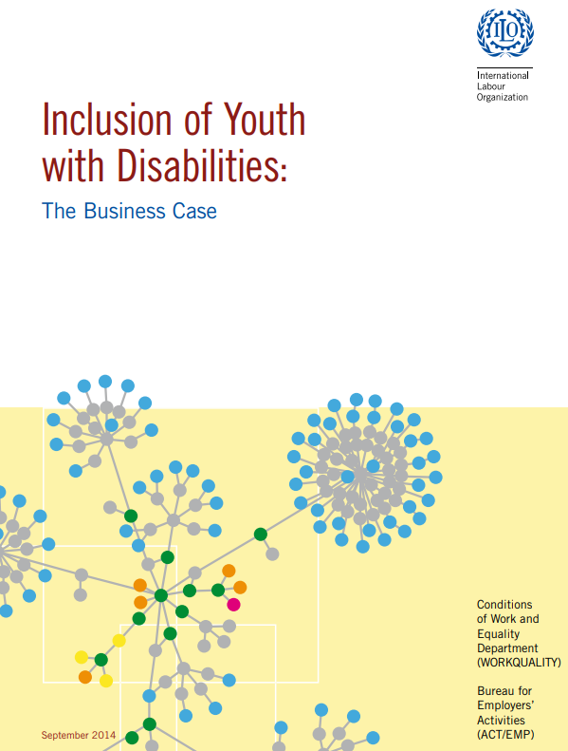
ILO work on the inclusion of youth with disabilities
Global Initiative on Decent Jobs for Youth
Mainstreaming disability issues into the initiative and its eight thematic priorities
Policy brief “Making digital skills initiatives inclusive of young persons with disabilities” (2022)
ILO Global Business and Disability Network
Inclusion of youth in disability-specific initiatives, e.g. “Digital in Demand” in Asia
Compilation of ten company practices “Inclusion of Youth with disabilities: The Business Case” (2014)
ILO Statistics Department’s databases
Youth Labour Market Indicators (YouthSTATS) – includes disability status
Disability Labour Market Indicators (DLMI)

