Slide 1
Equalizing access to the labor market for persons with disabilities
Experiences from Inclusion Works

Slide 2
Background
Inclusion Works was a 3-year consortium program with 11 partners, funded by FCDO, operational in Bangladesh, Kenya, Nigeria and Uganda.
As one of its goals, IW sought to “leverage increased action and investment from private, public and civil society actors to enable economic inclusion for women and men with disabilities through employment; in line with CRPD and SDG 8.”
The program aimed at finding solutions to address the “missing middle” by creating linkages between the supply (jobseekers) and the demand (employers).
The program worked with young jobseekers with disabilities through soft skills development and supporting a Bridge IT Academy in Kenya with the National Industrial Training Authority, among others.
This presentation will touch upon IDA’s experiences of supporting these initiatives.

Slide 3
What has worked
There is a growing commitment among employers to be inclusive.
The Accenture Skills to Succeed modules were adapted for the use of jobseekers with disabilities under this program. The practice showed that with adaption, reasonable accommodation and individual support jobseekers with disabilities can access and equally benefit from these programs.
The success of the Bridge IT Academy demonstrated that when inclusion is approached with the question “what can we do to ensure persons with disabilities can participate in a training” rather than “who can participate in a training”, in active collaboration with OPDs, the results are much more inclusive.
Things that have worked – adapting training to meet a diversity of accommodation needs, individualized support, having commitment from business leadership, among others.

Slide 4
What have we learnt
Implementation gap – stakeholders are not aware of disability legislation and policy
Exclusion of several groups, particularly those that are under-represented.
Lack of disaggregated data hinders policy planning.
Overemphasis on supply-side solutions or on reasonable accommodation does not translate to inclusive workplaces
Sustainability requires active engagement of OPDs in design and decision-making, resourcing, and strengthening organizational capacities
There is a need to move away from the idea of “putting people into jobs” and push for transforming workplaces to be more inclusive.
The business case for inclusive employment does not align with the principles in the CRPD unless it is rooted in social justice.

Slide 5
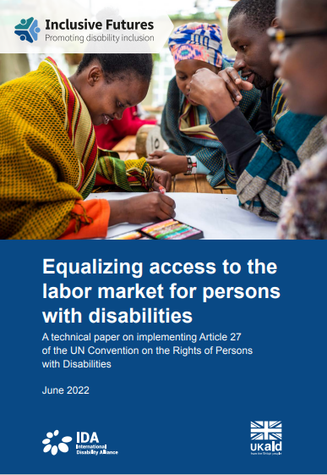
For details, please download the full report of IDA on implementing Article 27 here

